Slide 1
TrumpTwitter Bot
Using an RNN to generate Tweets
Ben Pierce SCS3546 (Deep Learning - University of Toronto) Semester 1, 2020

Slide 2
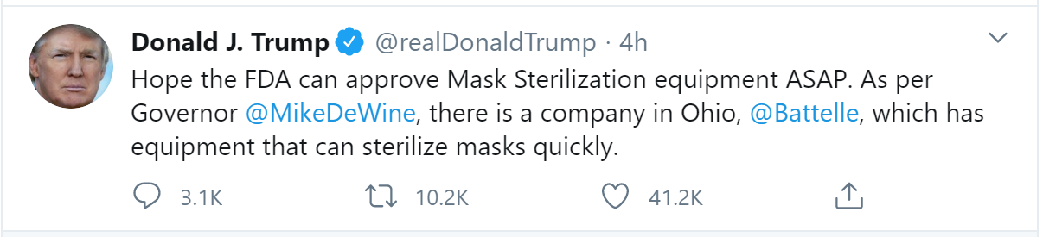
Purpose & Data Source
Tweet-like text generation using an RNN
Trained on a large volume of Donald Trump’s tweets (data source: http://www.trumptwitterarchive.com/archive)
With a good enough neural network, topics could be provided to the neural net, and opinions or sentiments could be mined and studied without having to interact with real individuals.

Slide 3
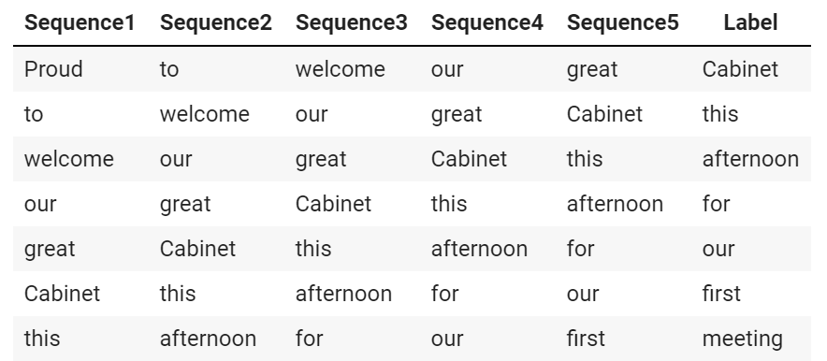
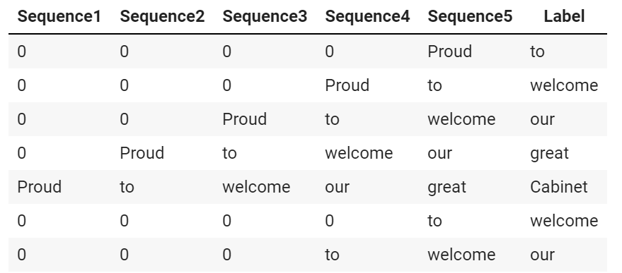
Model Types
Word-based vs Character-based tokens?
Word-based tokens mean accuracy of the model is going to be much lower because there are many possible word predictions; however, we don’t run the risk of the model predicting words that don’t exist.
Character-based tokens are going to have a higher accuracy because there are only 26 character predictions (plus symbols); however, we do run the risk of getting nonsense words.
Rolling sequences vs Padded sequences

Slide 4
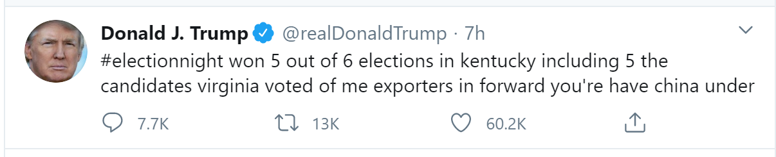
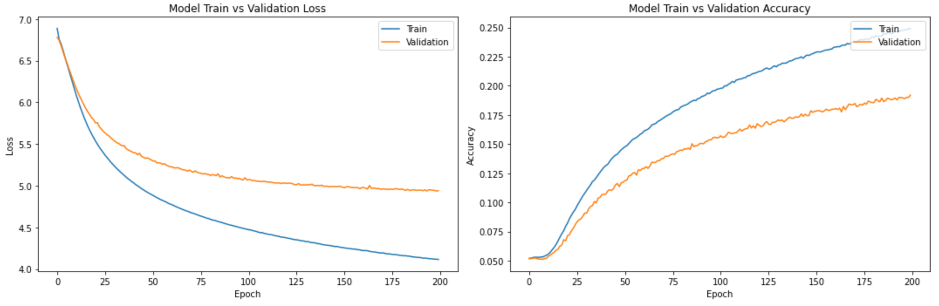
Word-Based / Padded Sequences
Padded sequences outperformed Rolling sequences.
Sequence length of 7 worked best for padded sequences.
As expected, only about 20% accuracy but still, decent learning curves.
Interestingly, was able to generate Farsi tweets.

Slide 5
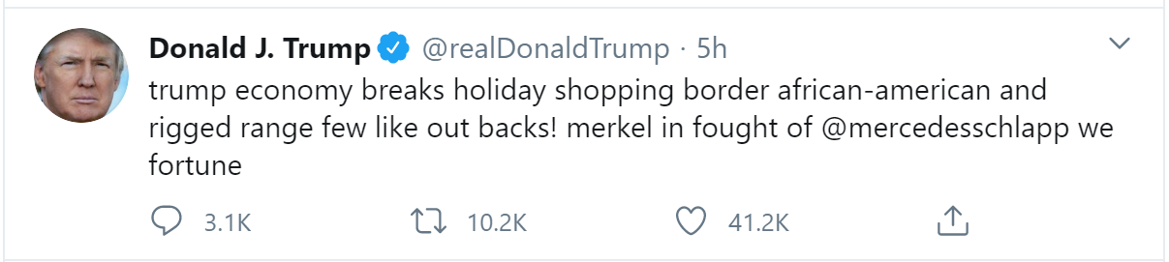
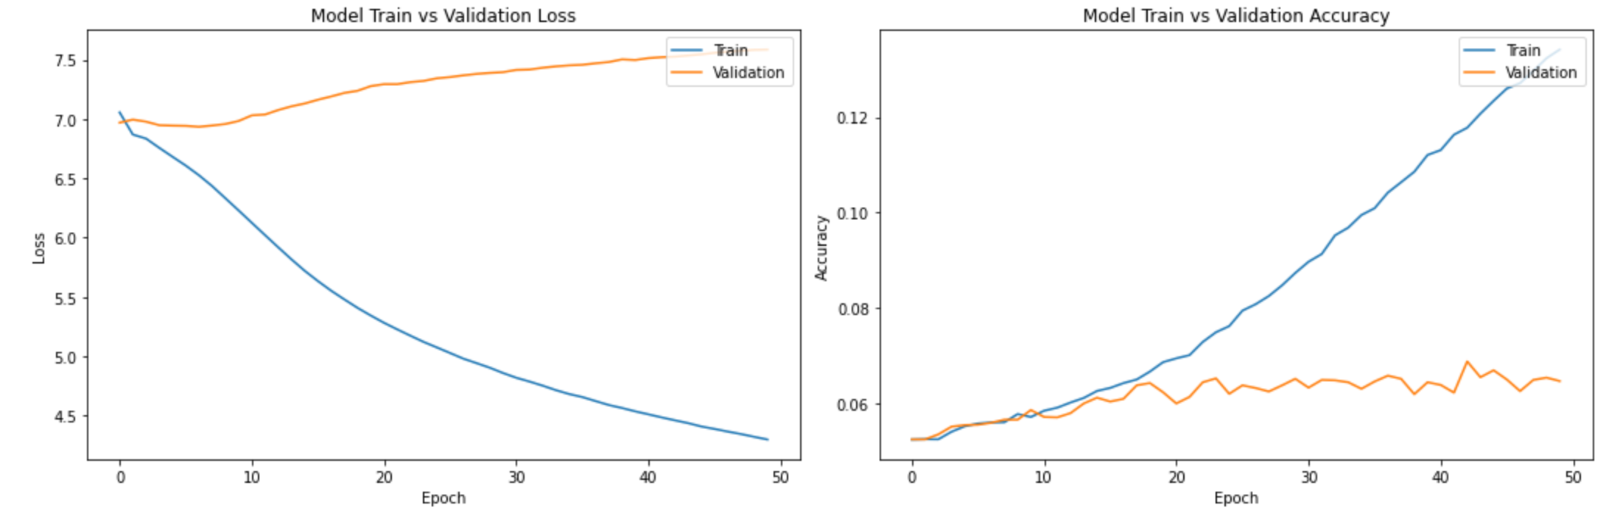
Word-Based / Rolling Sequences
Sequence length of 4 worked best for rolling sequences.
Model performed very poorly:
Low validation accuracy
Overfit almost immediately

Slide 6
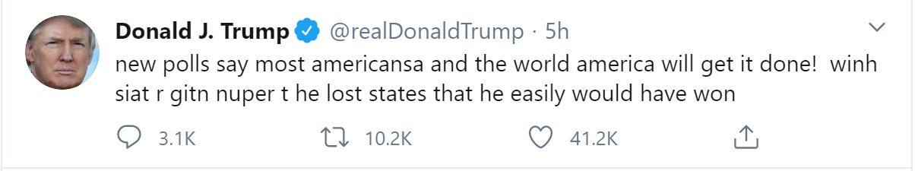
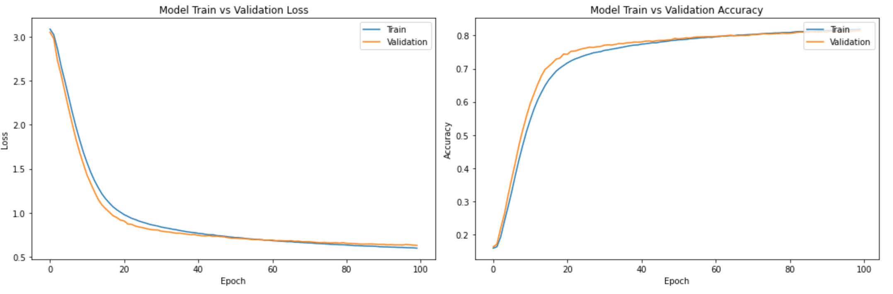
Character-Based / Padded Sequences
Validation loss & accuracy was very good (~85% accuracy) with a sequence length of 25.
Created some nonsense words when predictions went wrong “getting ready to meet thede orelry in madoaoos”
Showed good promise for further experimentation.

Slide 7
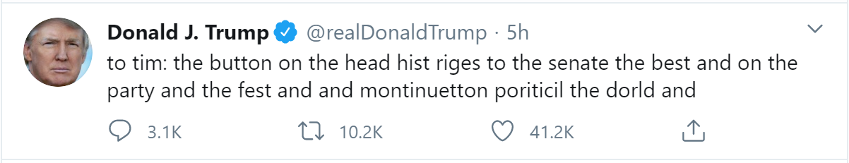
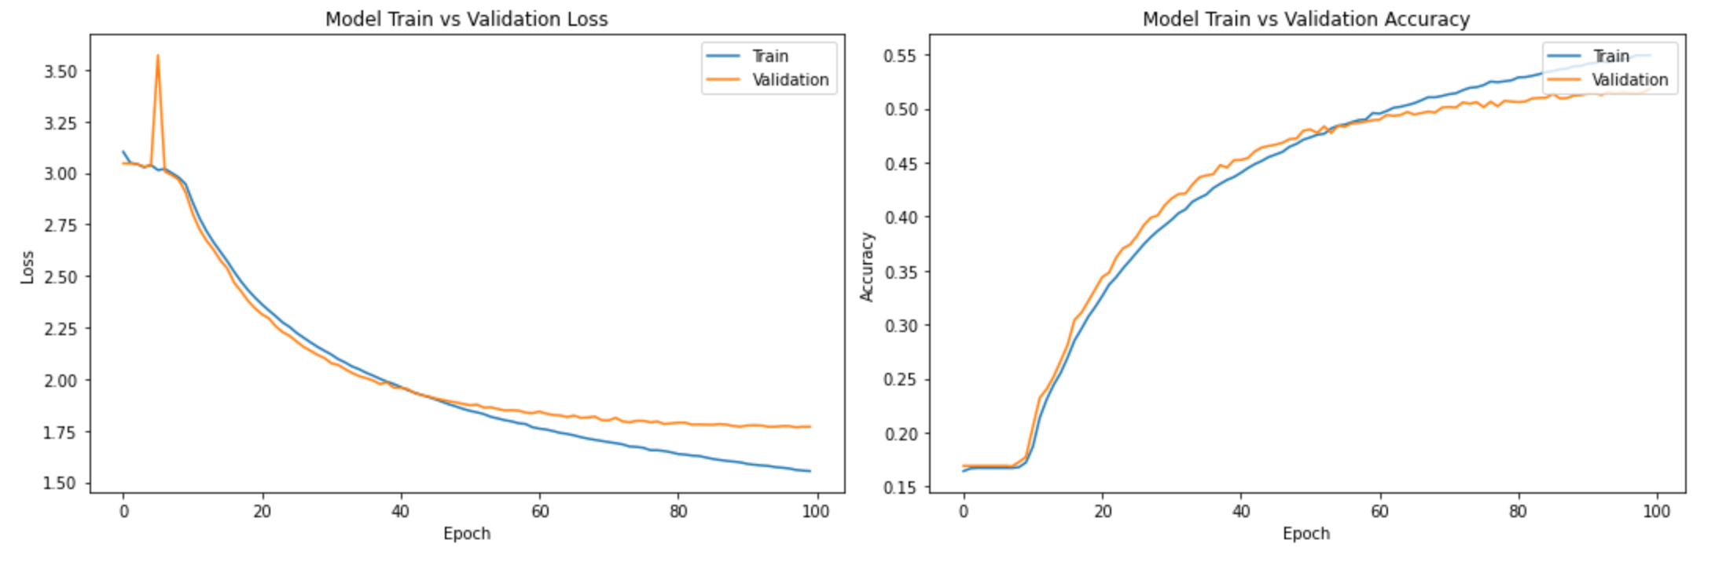
Character-Based / Rolling Sequences
Validation loss & accuracy was mediocre (~50% accuracy) with a sequence length of 50.
Created more nonsense words when predictions went wrong “the democrat prosicule saadeing the presid”
Would choose padded sequences over rolling sequences

Slide 8
Summary
Padded sequences greatly outperforms rolling sequences.
Word-based vs Character-based models both had good training metrics.
Areas for improvement:
Additional data cleanup of messy Twitter text
Train on much more data
Train in a reserved, cloud-based, runtime rather than on Colab.
Would choose word-based / padded sequences for future research.

Slide 9
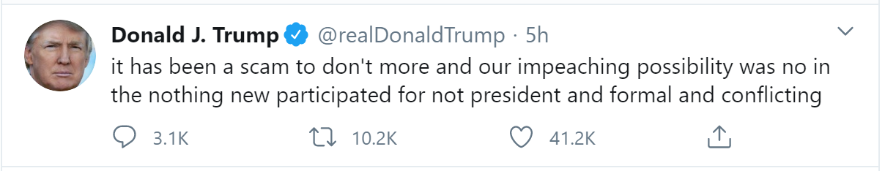
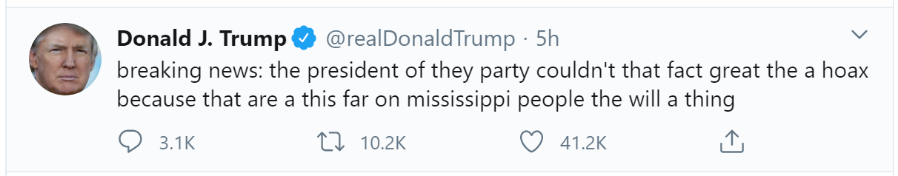
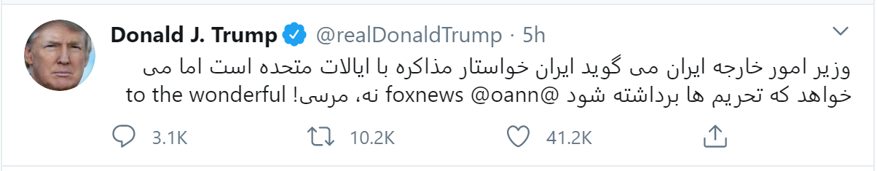
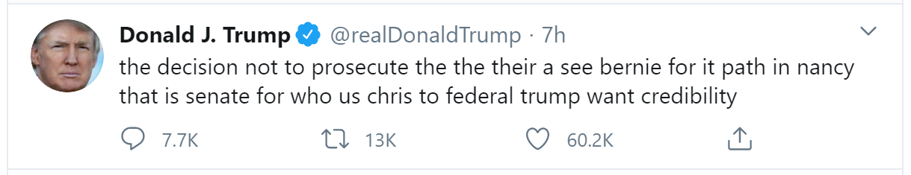
Thank You
Questions & Answers

